Slide 1
Helping your child to stay safe and thrive in the modern world
Heartwood CE VC Primary
& Nursery School
Notes:
Thank you for viewing this power point. You are experts on your child and we are keen to share what is planned for our new programme of RSHE so you can be informed and share your views.

Slide 2
We aim to provide a safe, nurturing environment and a rich variety of experiences so that all pupils are able to flourish and discover their unique strengths and talents. Our mission is to enable every child to enjoy a life filled with meaning and purpose, underpinned by Christian values, a love of learning and an eagerness to make the world a better place. “Live life in all its fullness” (John 10:10)

Slide 3
The world has changed…
Internet access to adult content
Gaming addiction
Sexualisation of society
Online bullying
Online exploitation
Gangs
Knife crime
Extremism
Fake news
Notes:
You might be wondering why the government has decided to make the topics of relationships education, sex education and health education statutory for all schools.
If you reflect on your own memory of relationships and sex education from when you were at school, it is likely that it was too little, too late and too biological. Not enough has changed to improve this today. The current guidance is 20 years out of date and a lot of has changed in that time. To help children and young people be safe, happy and healthy in the modern world, they need the information, values and skills, taught sensitively in an age and stage appropriate way to navigate the risks and take advantage of the opportunities available to them.
Research shows that effective teaching of relationships and sex education has a positive impact on children and young people. They are:
More likely to report sexual abuse, delay first sex until they are ready, engage in consensual sex, use contraception and condoms and less likely to have unplanned pregnancy or sexually transmitted infection.
The top three preferred sources of sex education for young people are: school, parents and health professionals.
bring the new guidance int We are going to start by reminding ourselves about some of the things that our children/young people are exposed to...
You may not have these magazine and computer games in your home, but your child may still see things like this in shops, other people’s homes etc.
From June 2019, under new rules, British companies will no longer be able to create promotions that depict men and women engaged in gender-stereotypical activities, amid fears that such depictions are contributing to pay inequality and causing psychological harm.
Adverts will no longer be able to show a person failing to achieve a task specifically because of their gender, such as a man unable to change a nappy or a woman unable to do DIY/park a car.
The rules will also ban adverts that suggest that transforming your body will make you romantically successful, while also clarifying rules on the sexualisation of young women.

Slide 4
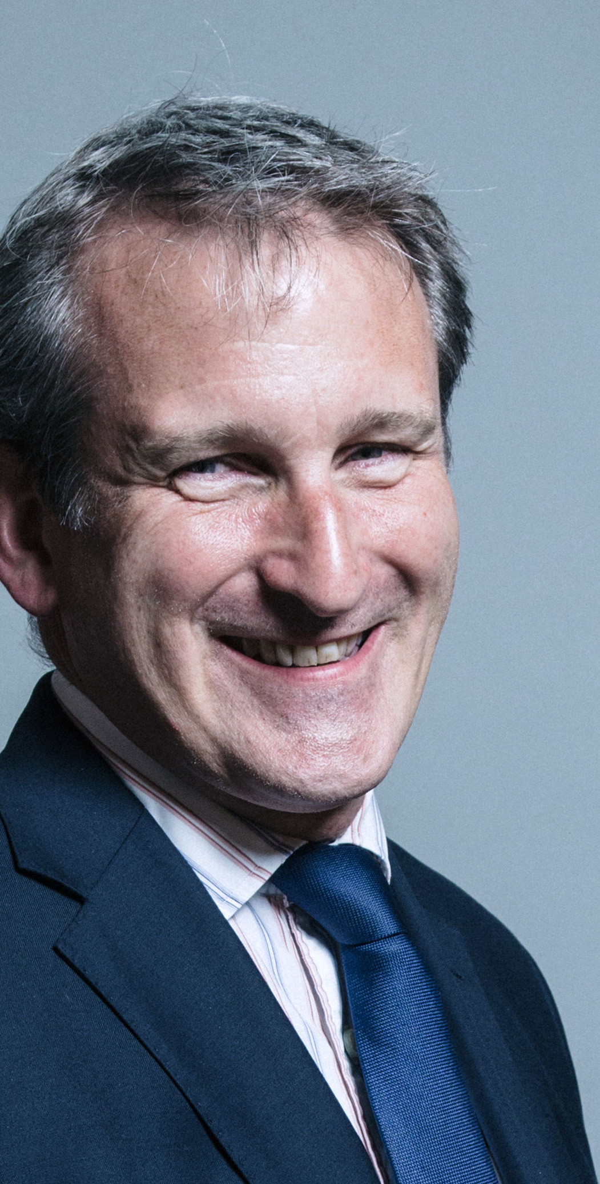
Secretary of State Foreword
“Today’s children and young people are growing up in an increasingly complex world and living their lives seamlessly on and offline. This presents many positive and exciting opportunities, but also challenges and risks. In this environment children and young people need to know how to manage their academic, personal and social lives in a positive way”.

Slide 5
Our school vision for RSHE is….
We aim to provide a safe, nurturing environment and a rich variety of experiences so that all pupils are able to flourish and discover their unique strengths and talents. Our mission is to enable every child to enjoy a life filled with meaning and purpose, underpinned by Christian values, a love of learning and an eagerness to make the world a better place. “Live life in all its fullness” (John 10:10)
Our vision statement reflects a passionate commitment to learning and recognition of the uniqueness of individual learners. It is driven by our desire to offer the best possible education for our pupils in partnership with parents, the Church and the local community.
Notes:
Explain how this supports the school ethos, values and school mission statement

Slide 6
PRIMARY RELATIONSHIPS EDUCATION Schools will be required to teach…
Families and people who care for me
Caring friendships
Respectful relationships
Online relationships
Being safe
Notes:
From September 2020, all primary schools in England will be required to teach a curriculum of relationships education. This includes:
Families and people who care for me
Caring friendships
Respectful relationships
Online relationships
Being safe
We are proud to have been teaching much of this already as part of our broad and balanced curriculum. The new guidance will not therefore require us to do lots more or much differently, but we are using it as an opportunity to build on our existing foundation of good teaching and learning and to make further improvements.
Our newly planned curriculum overview is available for you to see and we look forward to hearing your views on this.

Slide 7
HEALTH EDUCATION Schools will be required to teach…
Mental wellbeing
Internet safety and harms
Physical health and fitness
Healthy eating
Drugs, alcohol and tobacco
Health and prevention
Basic first aid
Changing adolescent body
Notes:
Additionally, from September 2020 all schools in England will be required to teach a programme of Health Education. This includes:
As well as being listed as an explicit topic, mental wellbeing will form an integral part of many of the lessons.
As with relationships education, we are proud to have been teaching much of this already as part of our broad and balanced curriculum. The new guidance will not therefore require us to do lots more or much differently, but we are using it as an opportunity to build on our existing foundation of good teaching and learning and to make further improvements.
Our newly planned curriculum overview is available for you to see and we look forward to hearing your views on this.
Parents have no right to have their child excused from any aspect of relationships education or health education.

Slide 8
Puberty as part of Health Education
Key facts about puberty and the changing adolescent body, particularly from age 9 through to age 11, including physical and emotional changes.
About menstrual wellbeing including the key facts about the menstrual cycle.
Puberty should be covered in Health Education and should be addressed before onset so, as far as possible, pupils are prepared in advance for changes they will experience.

Slide 9
Sex Education
Ensure boys and girls are prepared for changes of adolescence
Draw on knowledge of human life cycle in the NC for science – how a baby is conceived and born
The Department continues to recommend that all primary schools have a sex education programme tailored to the age and the physical and emotional maturity of the pupils.
Notes:
Whist it is not mandated in the new guidance, it is recommended that all primary schools have a sex education programe tailored to the age and physical and emotional maturity of its pupils. Teaching about how a baby is conceived and born, taught outside of national curriculum for science is the only part that parents are able to withdraw their child from.
Should this be your wish, whilst your request will be automatically granted in the primary phase, Before the head teacher can grant your request they are required to meet with you in person to discuss the nature and purpose of the curriculum, and where appropriate the wishes of your child. The benefits of receiving this important education and any detrimental effects that withdrawal might have on the child. This could include any social and emotional effects of being excluded, as well as the likelihood of the child hearing their peers’ version of what was said in the classes, rather than what was directly said by the teacher.
Schools are required to document the conversation to ensure a record is kept.
If this is your decision, we will respect your position as the primary sex educator for your child and can provide you with resources and guidance to support your teaching of this to your child.

Slide 10
How our school will teach this…
Each class will create a working agreement so pupils feel comfortable to join in the lessons;
All teachers will use correct scientific language when talking about parts of the body;
No pupil will be forced to join in an activity, or answer a question;
All genders taught together;
Teachers have been trained to teach these lessons;
Teachers are unlikely to, and pupils not be asked to share personal experiences;
All causes for concern raised as a result of the lessons will be dealt with according to the school safeguarding policy.
Notes:
Discuss any other factors relevant to the approach or delivery of RSE teaching at the school. For example, sensitive to faith perspectives

Slide 11
Top tips for talking to your child…
Use everyday opportunities
Be calm and relaxed
Really listen
Notes:
RSE will be taught according to statutory requirements, and inline with the ethos of the school and the framework of the school RSHE policy. It will be taught using inclusive resources in a non-judgemental way. It is important that as a family you take the time to share your personal values, beliefs and attitudes as relevant to the topics and also to create strong channels of communication with your child as early as possible.
Read our top tips for talking to your child guidance sheet. You can also contact us for any additional guidance and support.

Slide 12
These subjects represent a huge opportunity to help our children and young people develop. The knowledge and attributes gained will support their own, and others’, wellbeing and attainment and help young people to become successful and happy adults who make a meaningful contribution to society.

Slide 13
Support line numbers NHS Direct—111 Childline—0800 1111 (free) NSPCC—0808 800 5000 (www.nspcc.org.uk) Just One Number—0300 300 0123 Young Minds—0800 802 5544 (www.youngminds.org.uk) Citizen Advice Service Main Number - 0344 111444 Citizen Advice Service in The Forum—0800 144 8848 Age UK Norwich—01603 496333 MAP (under 25s, near Theatre Royal) - 01603 766994 Oak Grove Money Advice—01603 403388 Kings Money Advice—0800 970 9875 National Debtline—0808 808 4000 Change, Live, Grow (Addiction Advice Service) - 01603 514096
We are here to support you & your children

Slide 14
If you would like to discuss the RSHE provision further, please email the school office: office@heartwood.norfolk.sch.uk Miss Wellings RSHE Lead

